Slide 1
Agent-based modelling

Slide 2
What are we doing today?
Learn about agent-based modelling (ABM)
What is it?
What are the key concepts?
What is it for? The strengths and weaknesses of the method
ABM Examples
ABM tool - NetLogo

Slide 3
What is Agent-based modelling?

Slide 4
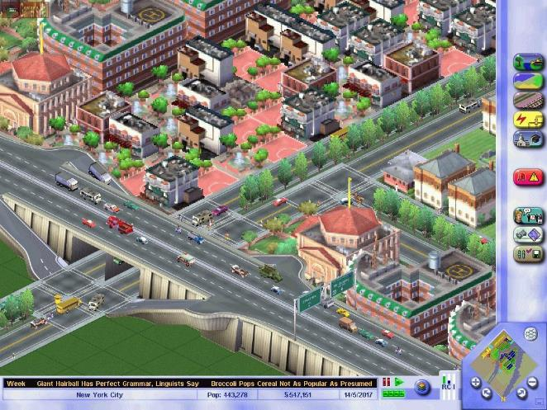
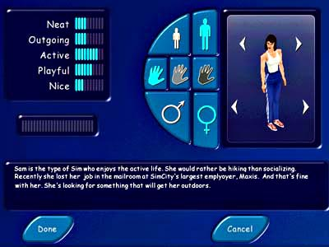
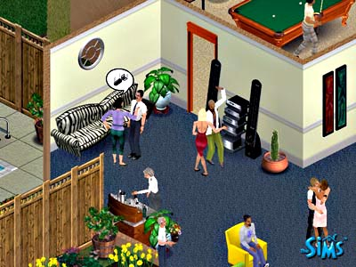
Agent-Based Modelling (ABM) – All about the individual
Computer simulation of autonomous, heterogeneous and interacting individual agents situated in a virtual environment

Slide 5
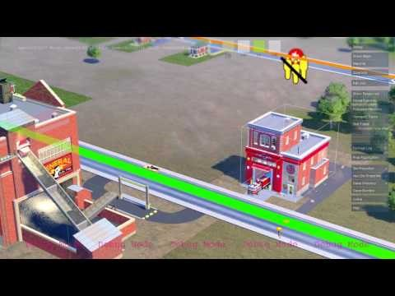
Example: SimCity
https://www.youtube.com/watch?v=vS0qURl_JJY

Slide 6
Aggregate vs Individual Level
‘Traditional’ modelling methods work at an aggregate level, from the top-down
E.g. Regression, spatial interaction modelling, location-allocation, etc.

Slide 7
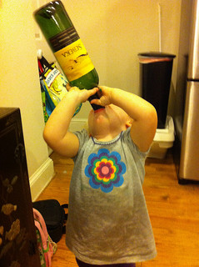
Aggregate vs. individual-level
Systems are driven by individuals
(cars, people, ants, trees, whatever)
Not controlled by god
Bottom-up modelling
An alternative approach to modelling
Rather than controlling from the top, try to represent the individuals
Model the individual behaviour directly
Let the system evolve by itself
Picture by Wayan Vota
(http://www.flickr.com/photos/dcmetroblogger/)

Slide 8
Aggregate vs. individual-level
Aggregate models work very well in some situations
Homogeneous individuals
Interactions not important
Very large systems (movement of people)
But they miss some important things:
Low-level dynamics, i.e. “smoothing out” (Batty, 2005)
Interactions (e.g. spread of COVID-19)
Emergence
Complex systems
Notes:
Batty, M. (2005). Agents, cells, and cities: new representational models for simulating multiscale urban dynamics. Environment and Planning A, 37:1373–1394.

Slide 9
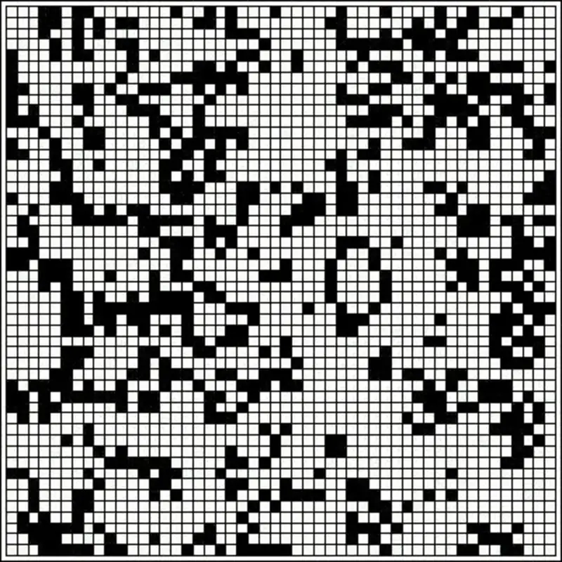
What is a complex system?
Lots of individual components (individuals, organisations)
Each have a relationship with other components
Changes over space
Changes over time
Unknown what the outcome is (emergence)
Game of Life: Cellular Automata
Notes:
e.g. game of life

Slide 10
What is an agent? (I)
No universal definition
But most people agree that agents should exhibit some of the following criteria
Autonomy
Act independently, free from central control
Control its own state and make independent decisions
Notes:
https://www.bartlett.ucl.ac.uk/casa/pdf/paper110.pdf

Slide 11
What is an agent? (II)
Heterogeneity
Agents should not normally be identical
Groups of similar agents are formed from the ground-up (e.g. by agents interacting with each other)
Reactivity
Agents can sense their environment and respond to changes
Responses should be goal-directed

Slide 12
What is an agent? (III)
Bounded rationality
Agents should not have full knowledge of the world (this would be very unrealistic)
Environmental perception can be limited
Choices will not be perfectly rational – they can make mistakes
Interactive
Agents can communicate with each other
Could be dependent on environment (e.g. distance)

Slide 13
What is an agent? (IV)
Mobile
Often agents will be able to navigate a space.
Learning / adaption
Agents should be able to adapt future decisions based on past experiences

Slide 14
Modelling human behaviour in ABM
Simple rules, rule of thumb
Rules from experts and practitioners in the (specialised) systems (e.g. farming, electricity market, auction)
Rational / Utility optimisation
Bounded rationality with limited information and cognitive capacity
Theory (e.g. Prospect Theory, Theory of Planned Behaviour, Social Identity theory)
Data-driven / machine learning approach
AI models
Belief–desire–intention
Deep/Reinforcement Learning
Notes:
Psychological theories: peer pressure (converge to norm), risk avoidance, loss aversion, ego depletion

Slide 15
ABM vs Microsimulation
What is microsimulation?
The generation of a population sample P made up of n individuals.
Each individual has a set of attributes.
Attributes can be updated over time.
Initial population often taken from population samples in large scale surveys

Slide 16
How does ABM differ from microsimulation?
Microsimulation:
Individuals do not interact with each other
Individuals updated at end of each iteration.
More suitable for upscaling and population projections
ABM:
Individuals interact with each other
Individuals can be updated asynchronously (and the order of update can be important!)
More suitable for modelling emergent phenomenon

Slide 17
Appeal of ABM – Natural way of thinking
Most ‘natural’ way of thinking about systems
Individual actions drive the system
Easier to communicate to others
Transparent assumptions
Behaviours validated by actual people in the system

Slide 18
Appeal of ABM – Modelling emergence
Emergence: The whole is greater than the sum of its parts
Outcomes that are hard to derive (mathematically) from initial conditions
Path dependence (different outcomes from the same initial conditions due to random events at some key points)
Unintended consequences
Notes:
Gilbert, N. (2004). Agent-based social simulation: dealing with complexity. http://www. econ.iastate.edu/tesfatsi/ABM.DealingWithComplexity.Gilbert.pdf [accessed - January 2007].

Slide 19
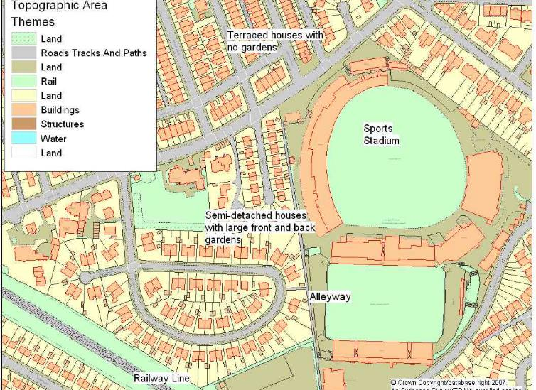
Appeal of ABM
Can include both physical space and social processes
Can represent heterogeneous agents
Can represent individual-level decision making in a more realistic way
Not limited to rationality
More complex and realistic behaviour
AI
Designed at abstract level: Easy to change scale
Notes:
“The appeal is undeniable: it appears obvious that individual-level decision making is the fundamental driver of social systems” (O’Sullivan et al. 2012)

Slide 20
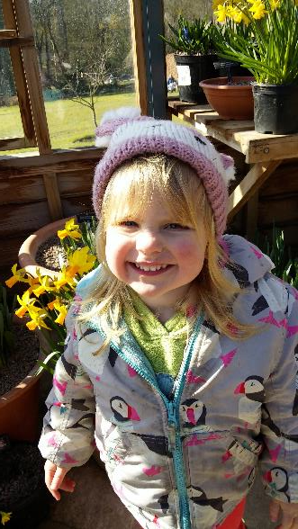
Disadvantages of ABM
Known unknowns
We don’t know exactly what someone will do.
So we guess
E.g. There is a 30% change of attending this lecture, and 70% chance of staying in bed
Models that use randomness like this are probabilistic
The need to run many times to ensure robust results
Calibrating and validating
Notes:
‘Known unknowns’ comes from a quote by Donald Rumsfeld:
“... there are known knowns; there are things we know that we know. There are known unknowns; that is to say, there are things that we now know we don't know. But there are also unknown unknowns – there are things we do not know we don't know.”
See the wikipedia article: https://en.wikipedia.org/wiki/Unknown_unknown

Slide 21

Disadvantages of ABM
Computationally expensive.
Complicated agent decisions
Lots of decisions!
Lots of agents
Multiple model runs (robustness)
Modelling “soft” human factors
Good that we can include complex psychology
But this is really hard!
Potential to over-complicate
Need to think carefully about what to include
Notes:
Over-complication: If the model is too complicated to analyze, all we have done is to replace one poorly understood object of study with another, which we know to be incomplete! (O’Sullivan et al. , 2012)

Slide 22
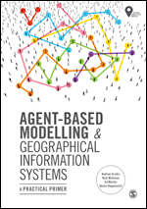
2018

Slide 24
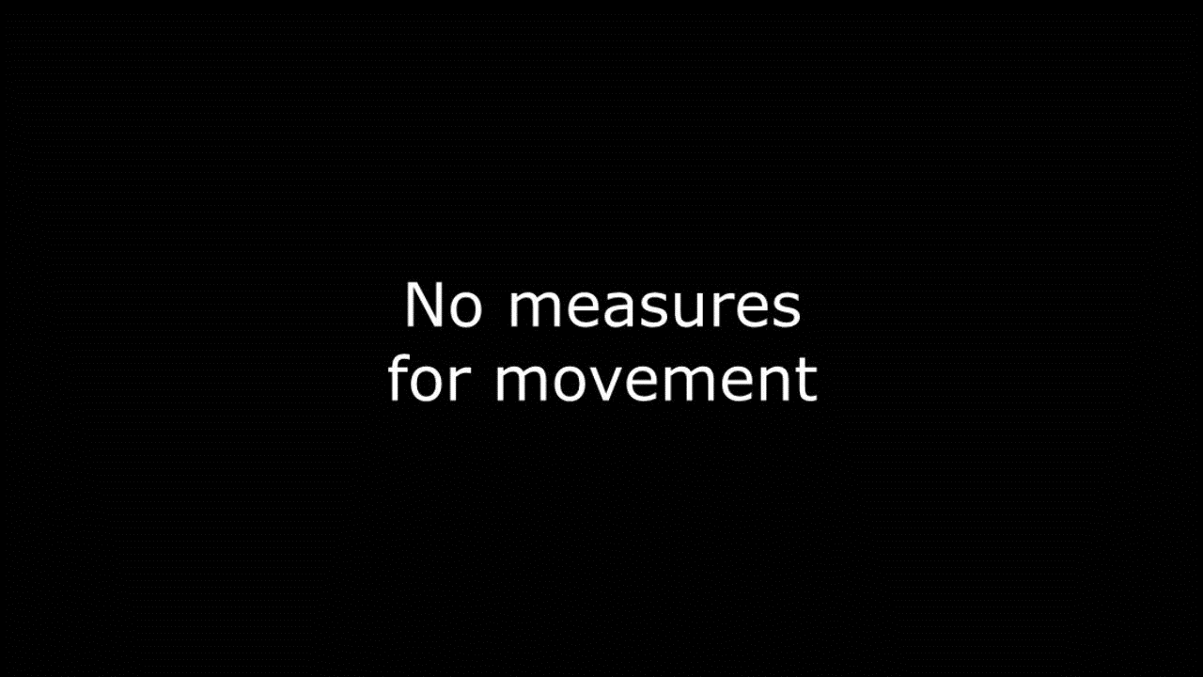
ABM Example: COVID-19 measures
Source: Washington Post https://www.washingtonpost.com/2020/world/corona-simulator/

Slide 25

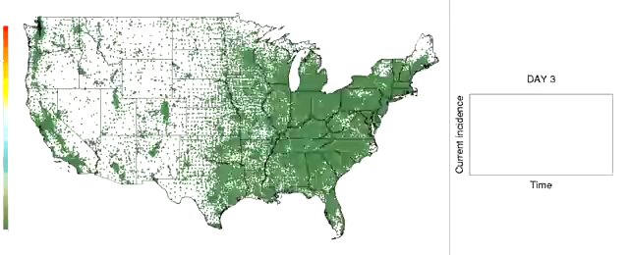
Example 2: Simulation of a flu pandemic outbreak in the continental United States, initially introduced by the arrival of 10 infected individuals in Los Angeles
Large-scale agent-based simulation (280 million people)
Ran on a super computer
Each dot represents a Census tract and changes color from green to red as more people in that tract become infected
Source: http://tinyurl.com/4oxxx3l & http://tinyurl.com/4lerjwv
Notes:
Focus is on peoples movement throughout the continent (Ran on a super computer)
Large-scale agent-based simulation involves 280 million people,
Uses demographic and worker flow data at the Census tract level,
Long-range travel statistics, to describe the geographic movement of people.

Slide 26
When to use ABM
Interactions between agents and multiple systems are important
Research is interdisciplinary (e.g. social and natural research)
Realistic behaviour in a real-world setting
Heterogeneous agents (land patches, species, humans, social groups…)
Complex system and emergent outcomes
Rich individual-level data or network data are available

Slide 27
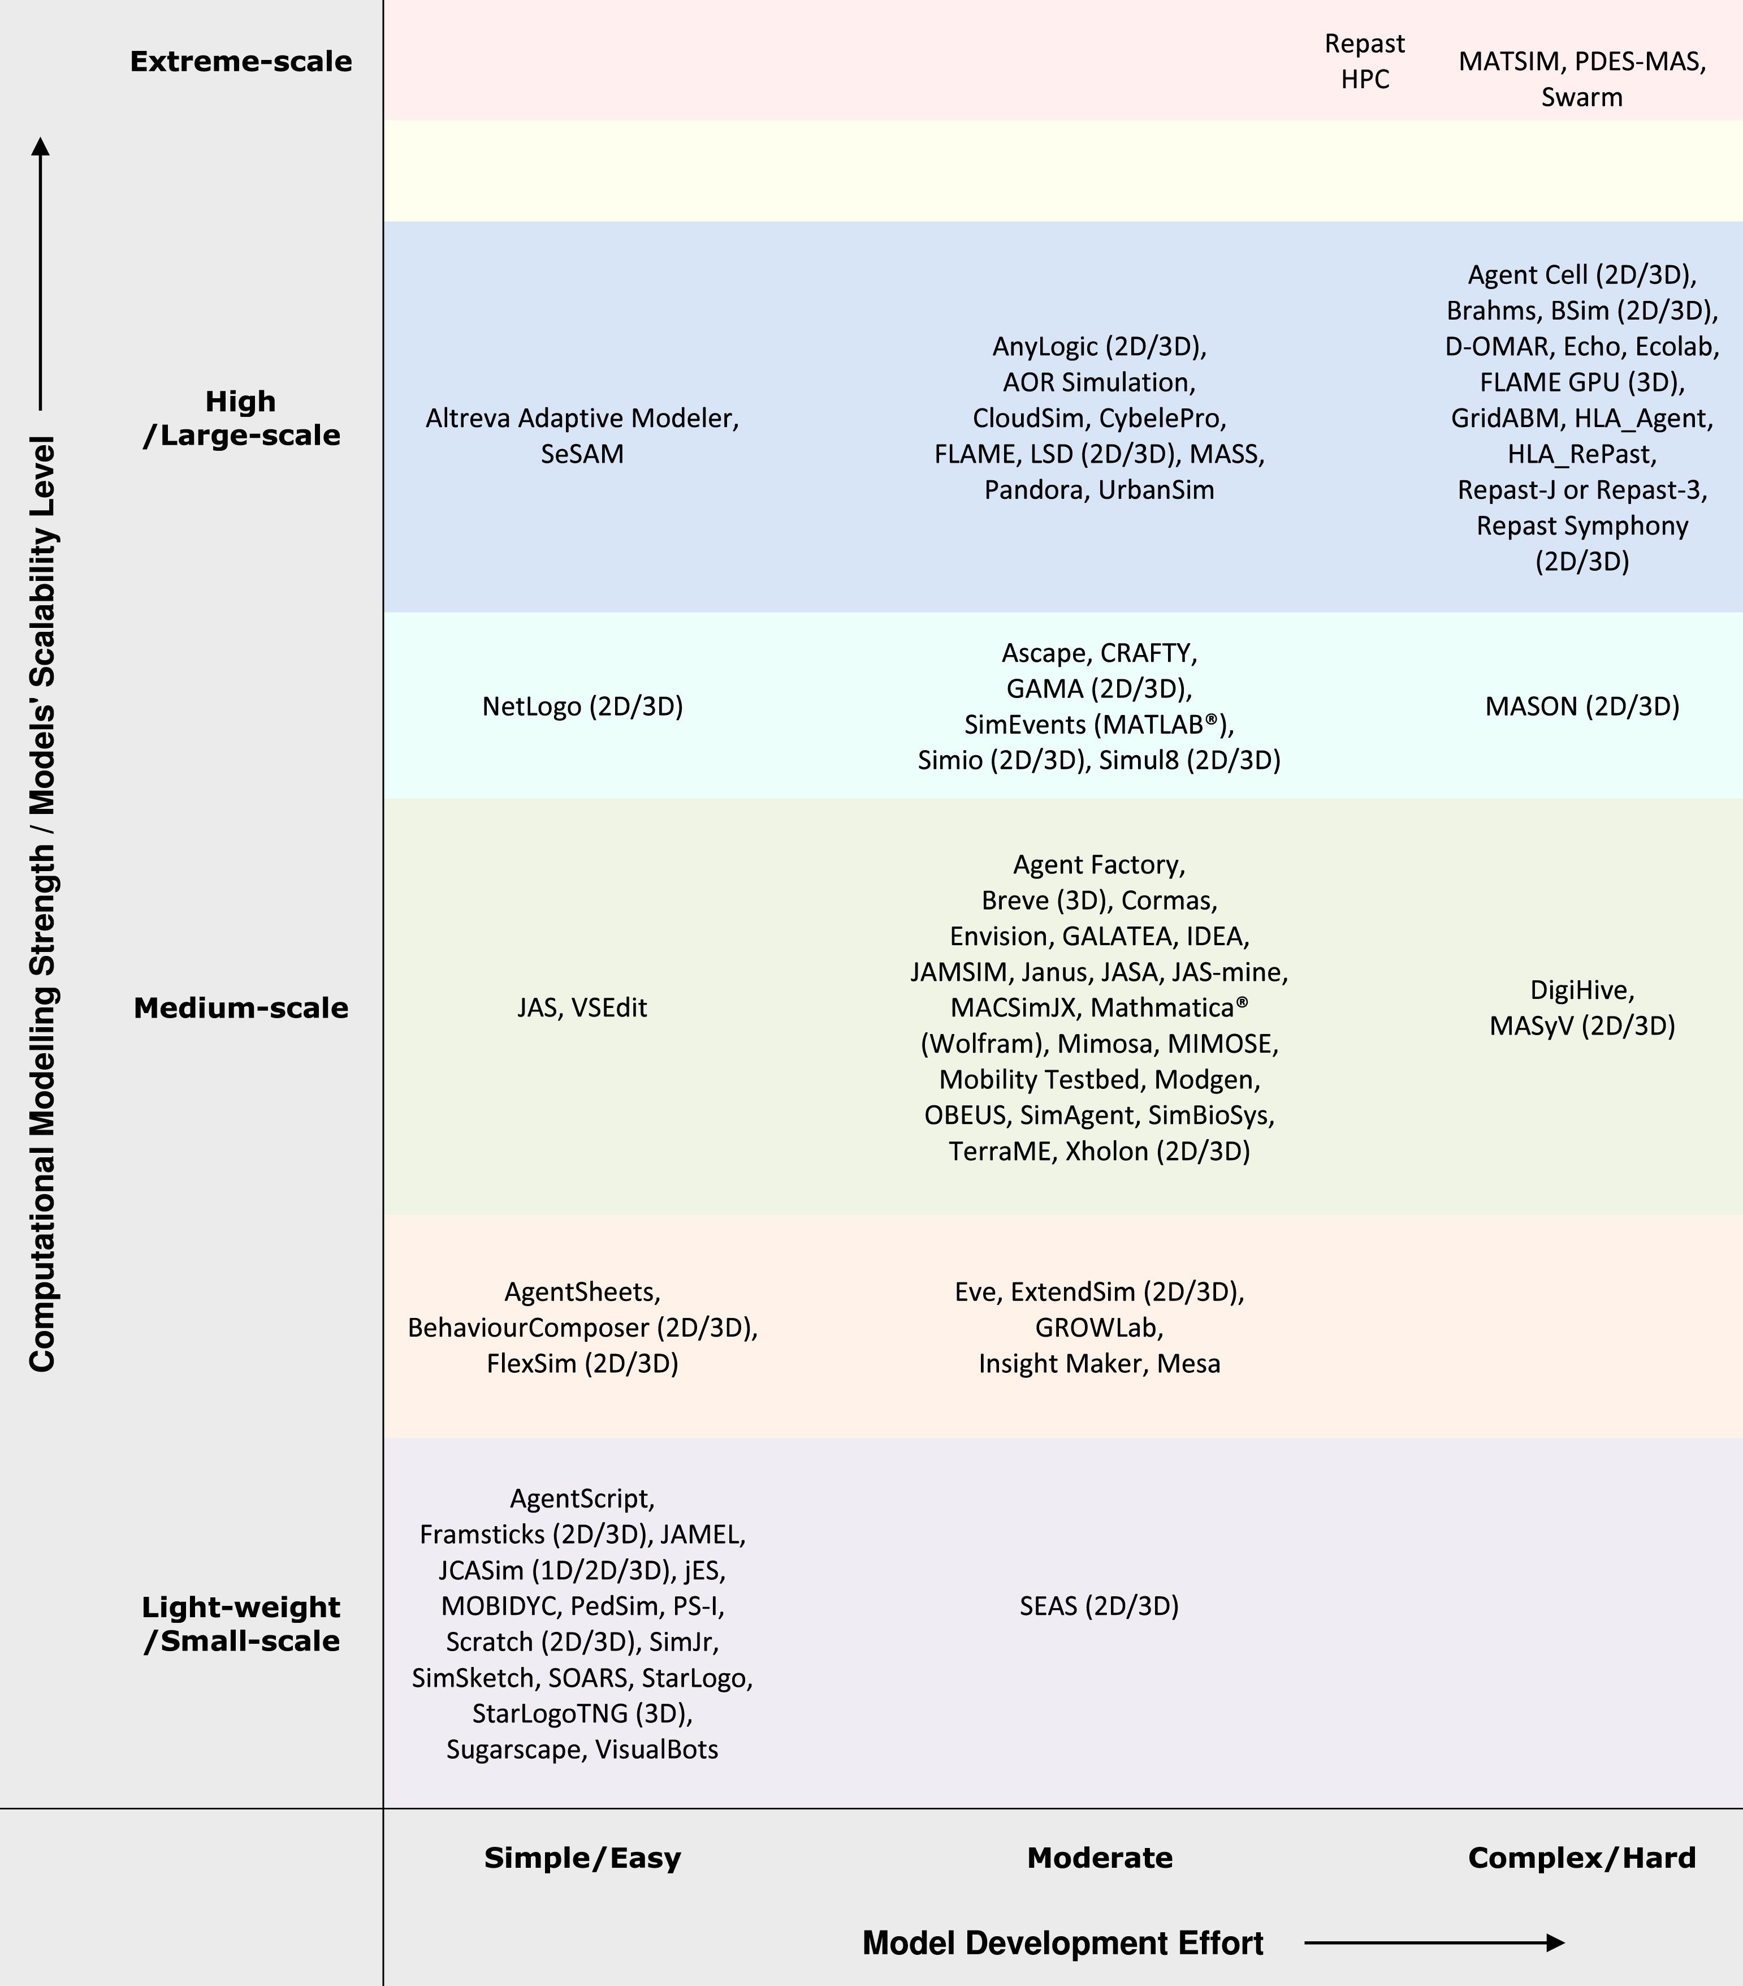
Available ABM software tools
Abar, Sameera, et al. "Agent Based Modelling and Simulation tools: A review of the state-of-art software." Computer Science Review 24 (2017): 13-33.

Slide 28
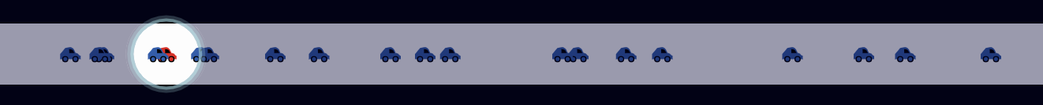
NetLogo Example – Basic traffic simulation
http://www.netlogoweb.org/launch#http://www.netlogoweb.org/assets/modelslib/Sample%20Models/Social%20Science/Traffic%20Basic.nlogo
Think about: How does a traffic congestion form?

Slide 29
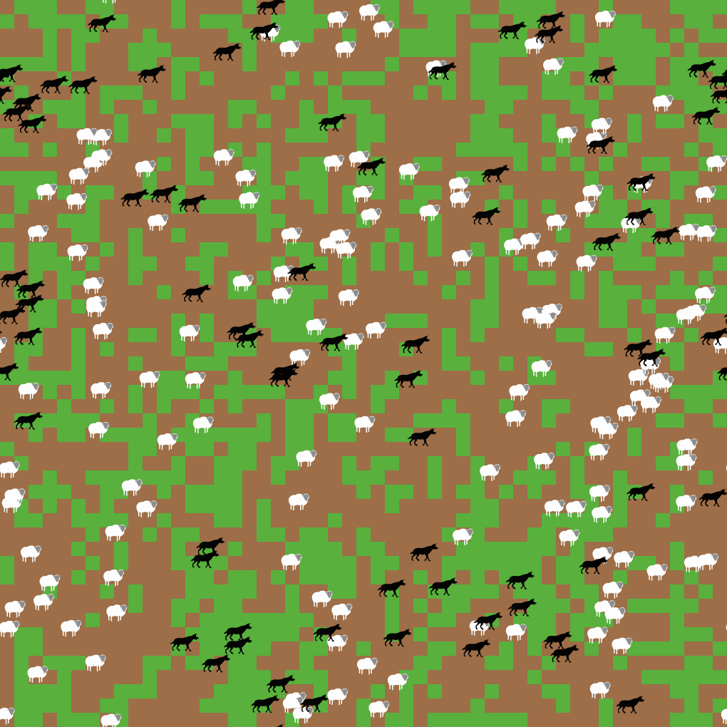
Netlogo example: Wolf sheep predation
http://www.netlogoweb.org/launch#http://ccl.northwestern.edu/netlogo/models/models/Sample%20Models/Biology/Wolf%20Sheep%20Predation.nlogo
Think about
Is the wolf-sheep-grass system stable?
Under what conditions is the system stable?
Under what conditions will the wolf go extinct?

Slide 30
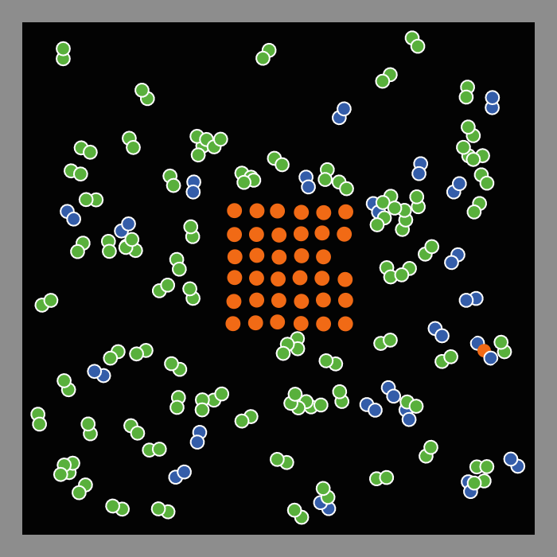
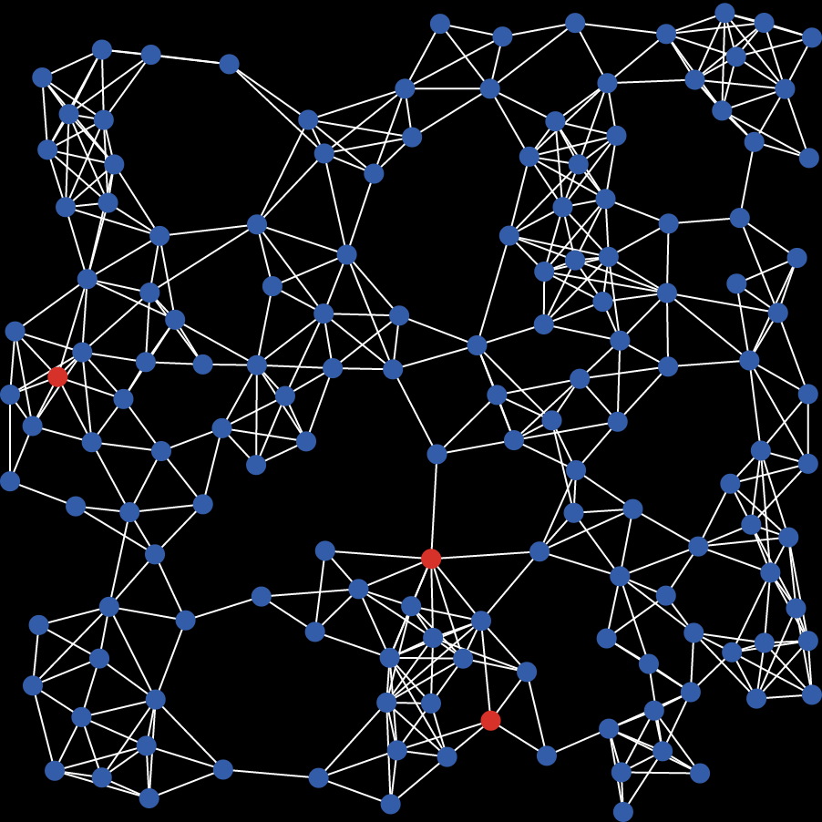
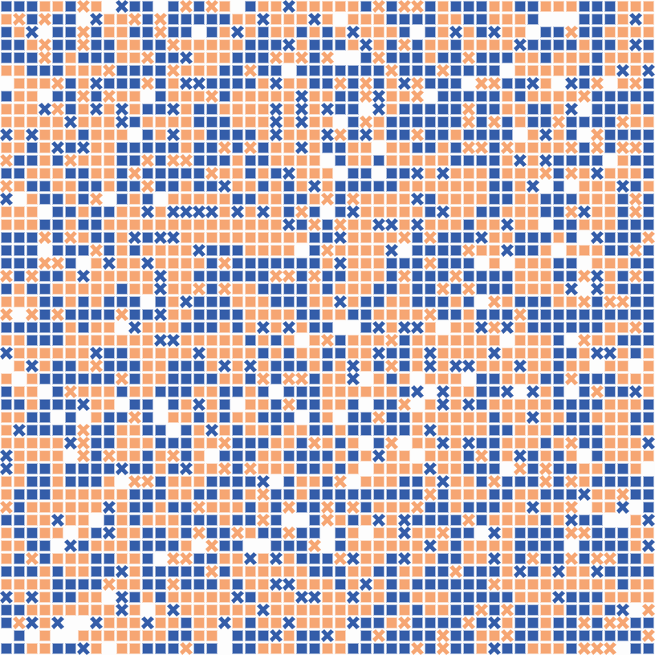
Have a go at NetLogo yourself!
https://ccl.northwestern.edu/netlogo/ and go to NetLogo Web
Combustion reaction
Virus spread network
Neighbourhood segregation

Slide 31
Practical SESSION: USING NETLOGO TO BUILD AN abm

Slide 32
Reading list
Crooks, A., Malleson, N., Manley, E., & Heppenstall, A. (2018). Agent-based modelling and geographical information systems: a practical primer. Sage.
Brunsdon, C. and Singleton, S. (2015) Geocomputation: a practical primer, p392 pages, SAGE. Edmonds, B., Meyer, R., 2013. Simulating social complexity : a handbook . Springer-Verlag, Heidelberg.
Gilbert, G.N. and Troitzsch, K.G. (2005) Simulation for the social scientist . Open University Press, Maidenhead, England; New York, NY.
Heppenstall, A.J., Crooks, A.T., See, L.M. and Batty, M. (2012) Agent-based models of geographical systems . Springer.
O’Sullivan, D. and Perry, G.L. (2013) Spatial simulation : exploring pattern and process . John Wiley & Sons Inc, Chichester, West Sussex, UK.
Tesfatsion, L., & Judd, K. L. (Eds.). (2006). Handbook of computational economics: agent-based computational economics (Vol. 2). Elsevier.
Hamill, L., & Gilbert, G. N. (2016). Agent-based modelling in economics. UK: John Wiley & Sons.
Gilbert, N., & Terna, P. (2000). How to build and use agent-based models in social science. Mind & Society, 1(1), 57-72.

